Slide 1
Weekly report: Machine Bed & Yaw System
Week No - 13
Date: 23.12.2025
Supervisor: Prof. Peter Quell
Shoukat Abbas, Luksh Chawla, Sathishkumar Venkatachalam, Shrihari G Kadam
Presented by – Shoukat Abbas

Slide 2
Contents
Machine Bed Design Changes
Rear Machine Bed
Assembly Update
Cost Analysis
References
Shoukat Abbas

Slide 3
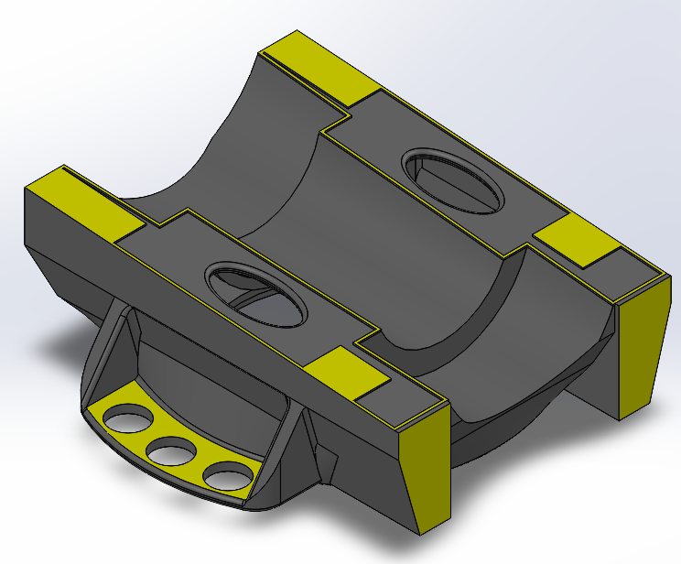
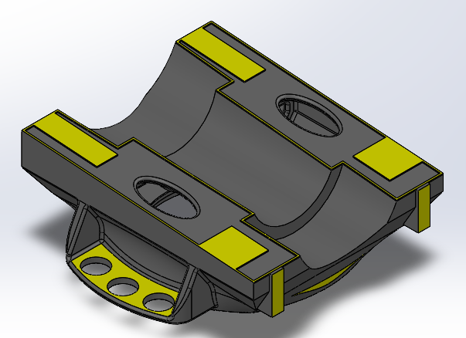
Machine Bed – Optimization
Machine Bed - 3D
Shaft and Bearing modifications
Dimensions changes
Fixing positions extended
Shoukat Abbas

Slide 4
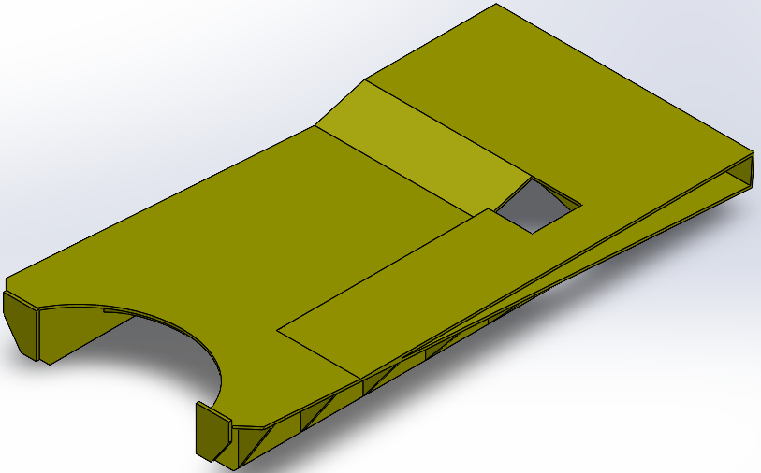
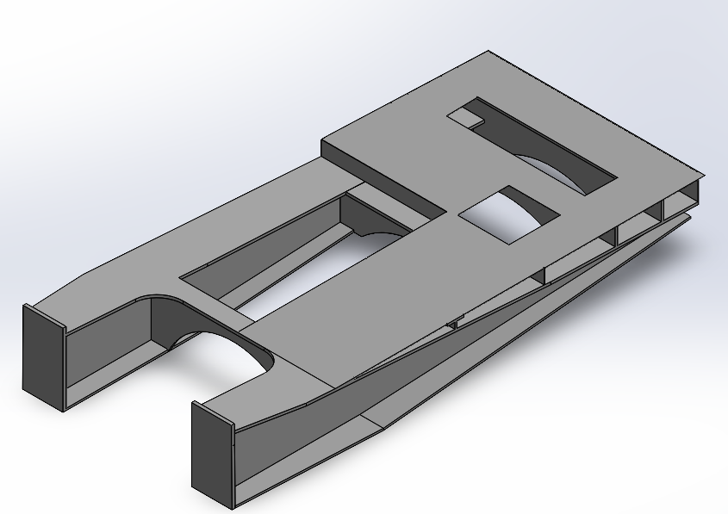
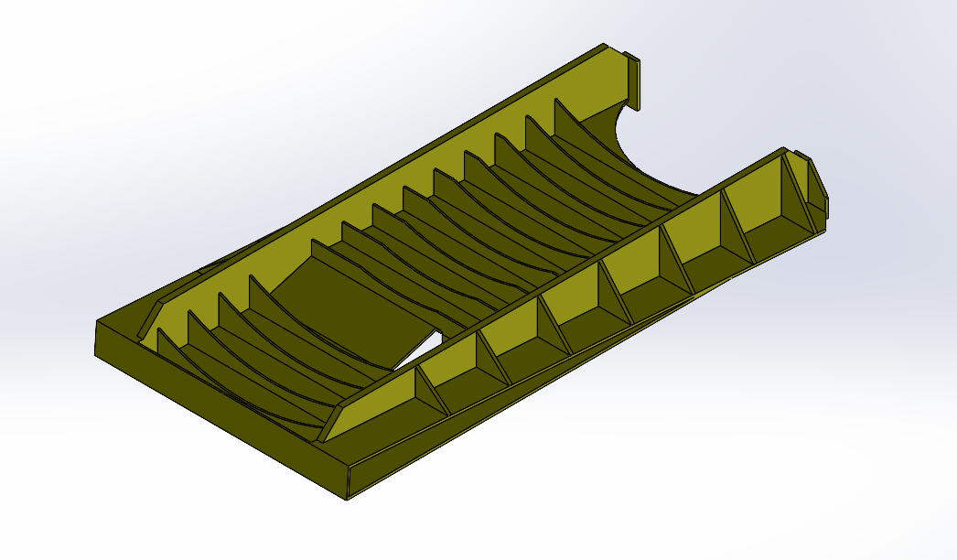
Rear Machine Bed – Design
* Own model- Concept Design
* Optimus Syria - Final Design
Shoukat Abbas

Slide 5
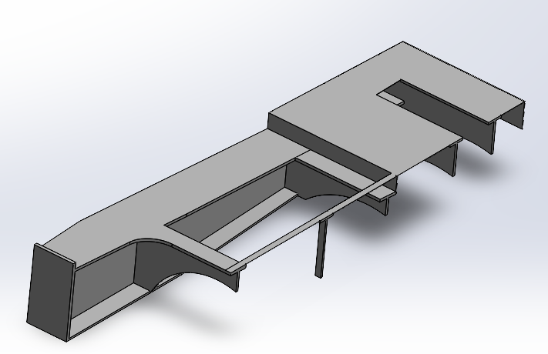
Updated Rear Machine Bed
Cross-sectioned view Simple
H-Beam Structure
Shoukat Abbas

Slide 6
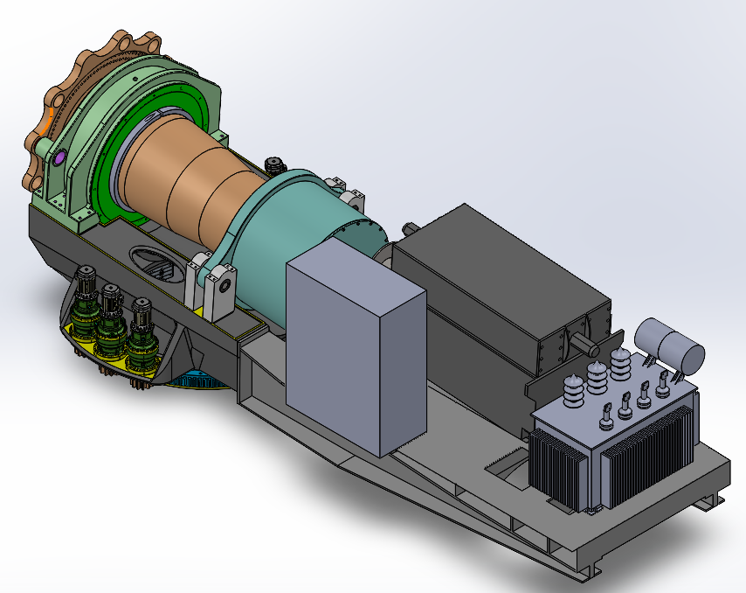
Updated Machine Bed & Yaw System Ass.
Shoukat Abbas

Slide 7
Cost Analysis
Components | weight per component (kg) | Cost | Total
Yaw Drive | 700 | 6750 in series production
 |  | 6 x 6750 € | 40.500 €
Brake Calipers | 210 | 3500 per caliper
 |  | 14 x 3500 € | 49.000 €
Brake Disk | 1751,3 |  | 3822,00 €
Yaw Bearing | 4293,1 |  | 24.508,20 €
Machine Bed casted | 35329.09 | 2 € / kg | 70.658 €
Machine Bed welded | 16339,06 | 2,5 € / kg | 40.847,65 €
[2].
Shoukat Abbas

Slide 8
References
    Optimus 92 LE (Previous Concept) __ Report_Optimus92LE_Machinebed_Yawsystem.lnk Accesed ( 12/11/2025)
    [2]. Latest Prices of Steel construction jactio. https://jactio.com/en/kostenfaktoren-im-stahlbau/
Shoukat Abbas

